Slide 1
Background
Income Verification as a Service
P

Slide 2
IVaaS long-term vision

Slide 3
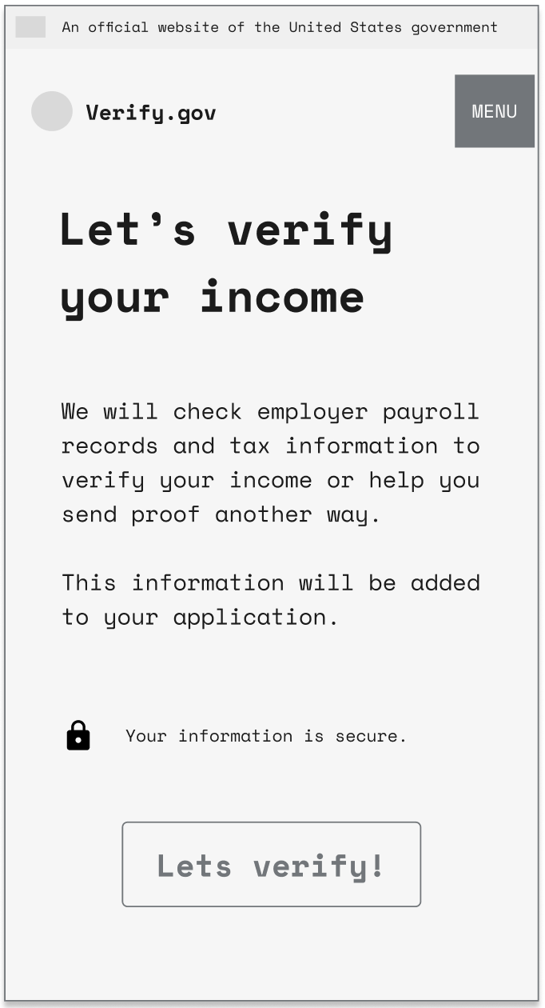
Background | Income Verification as a Service
Income Verification as a Service: Where it all began
Safety Net Benefits
To access benefits like SNAP & Medicaid, proof of income is required to determine eligibility, with nuances for each program
Income Verification as a Service
Federal tools to aid in verifying income that increase payment integrity, operational efficiency, and customer service across benefit program.
*working concept name

Slide 4
The income verification process for means based programs is riddled with challenges
Key Challenges
Applicants: struggle with knowing what data to provide and gathering it efficiently
Workers: challenged by managing fragmented processes, not knowing what data to trust, and short turnaround times to review cases within
State Agencies: third party income verification services prices increase exponentially, constant regulatory and compliance changes to keep up to date with, and increasing operational cost pressures as client populations remain high post pandemic
Benefit Programs: errors impacting program integrity, increased congressional scrutiny on means tested benefit programs

Slide 5

The goal is to create a verification process that is inclusive, transparent, trustworthy, integrated, and efficient.
Applicants should only have to provide information the state doesn’t already have, the information they need to submit should be clear, and it should be quick and easy to provide the information needed.
Caseworkers should feel confident about the verifications they receive and should spend minimal time requesting documentation from clients.
States should be able to focus and optimize their budgets on benefits over administration and technology costs.

Slide 6
Transforming Income Verification
We are on a journey to build an income verification platform that offers a seamless way to verify income, no matter the state, benefit program, or applicant's income earning type.
Core Features
Impact
Front Door: Serves as a centralized entry point for income verification​
Personalized Interventions: Matches the applicant to the most appropriate intervention for their situation​
Automation First: Leverages automated data before burdening applicants with user facing interventions​
Standardized Reports: Produces reports with the necessary data to make eligibility determinations
Applicant: Efficient benefit delivery with minimized income verification burden
Workers: Easy-to-read income reports for faster, more accurate eligibility determination
States: Reduced benefit processing backlog due to worker efficiency
Benefit Programs: improved program integrity by lowering error rates

Slide 7
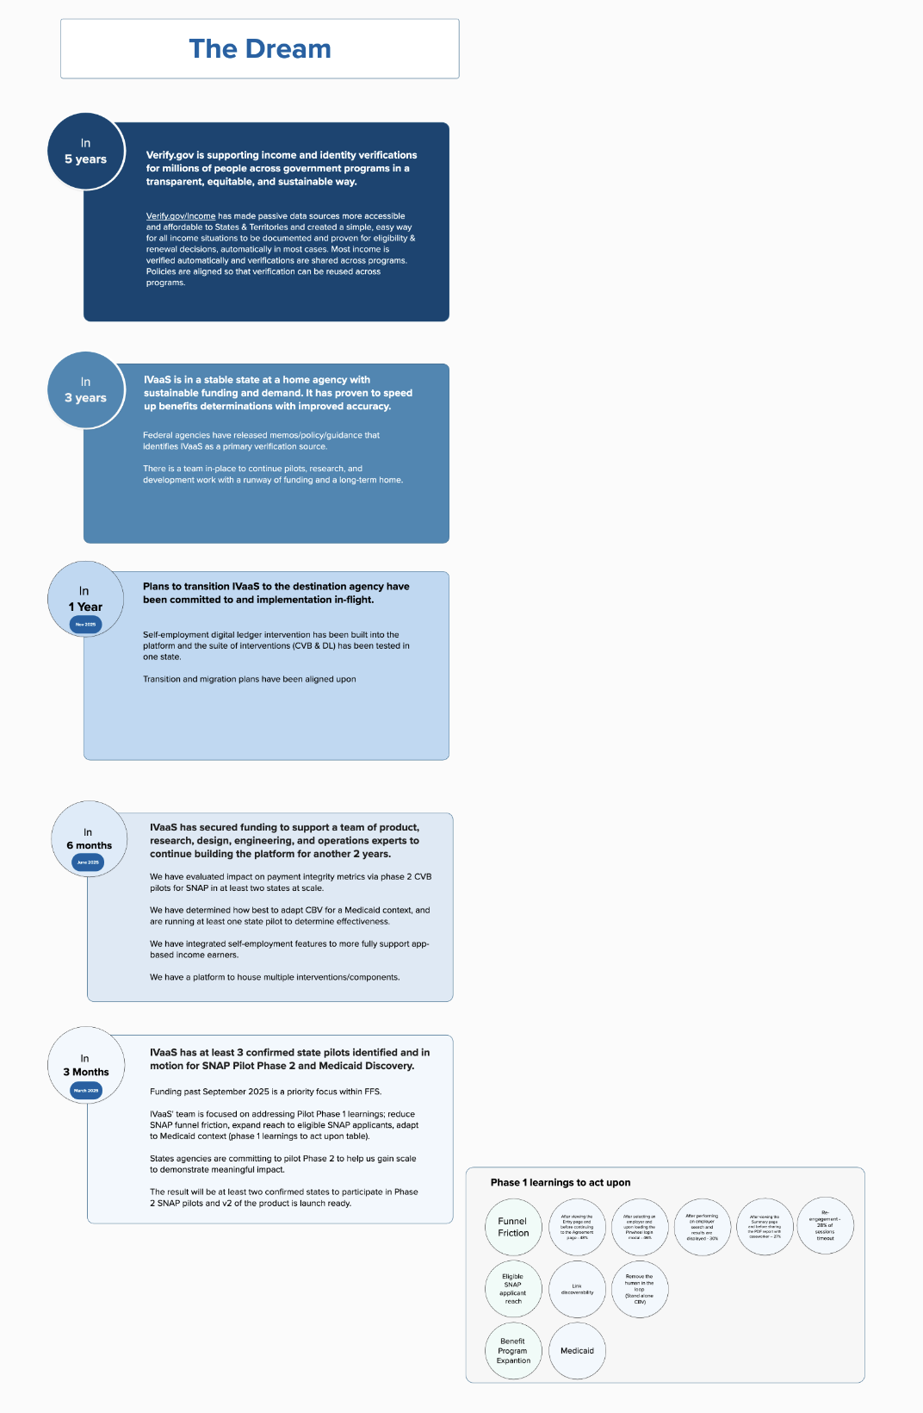
Long-term vision: The Aspiration for the public
One day, both the public AND means tested benefit programs will have a one stop income verification service.
Outcomes for the public:
Where possible, most verifications are done automatically and do not require applicant interaction.
When an applicant can't be verified automatically, there is a path to verify any form of earned income in every jurisdiction in the country through one platform.
Verifications are done in a clear plain language tool that reduces administrative and psychological burden to the greatest extent possible.
Applicants can verify their income once and choose to share with all means tested programs they're applying to.

Slide 8
Long-term vision: The Aspiration for Benefit Programs
One day, both the public AND means tested benefit programs will have a one stop income verification service.
Outcomes for programs:
Eligibility related payment errors have dropped to below congressionally mandated acceptable error levels
Few, if any states, have a corrective action plan based on their payment error rate or income verification processes.
The Income Verification Service has been formally stamped as compliant by all federal agencies where it is in use.
There is a clear and affordable cost structure for the Income Verification Service. Every state in the country pays the same price per verification.
The federal government is efficiently spending taxpayer dollars to ensure program integrity of means tested benefits.

Slide 9
Different interventions to improve income verification are being piloted
We automate income verification where we can using free government data sources first.
We create an accessible way for applicants to verify their income when the verification can't be automated
We define and share best practices for income reporting customer experience.
We advocate for changes to improve the process and system.

Slide 10
The IVaaS platform’s vision is to verify income across benefit programs and earner types, currently focusing on interventions for traditional "W-2" earners and app-based earners for SNAP and Medicaid programs.
Income earner types
IVaaS intervention
W-2, “traditional”, earners
Consent-based verification to directly access pay information
Helping applicants use their payroll credentials (login and password) to access recent paystub or proof of employment termination
App-based earners
(Ride share drivers, DoorDash, etc)
Accurate business-related expense reporting
Guiding self-employed applicants to report their business-related expenses in a way that works for agencies and benefit programs
Detailed profit and loss records
Guiding applicants to report detailed earnings for self-employment income
Self-employed earners
Smart document uploading with new technologies
Using the latest technology to improve the quality of documents submitted to agencies
Cash income earners
Key
FY 25 focus area
Future feature

Slide 11
FY25 Objectives and Goals

Slide 12
Phases of Work ***
Each priority area will move through discrete phases. Not all concepts will move to pilot or scaling phase.
Start
Nov 2023 – Jan 2024
Feb 2024 – Aug 2024
Sept 2024 – Sept 2025
Research Sprint 1 month
Design & Test 1 -3 months
State Pilots 3 - 6 months
Scale Nationally
6-12 months
Research Sprint
4-week baseline
to define and validate specific needs for income verification at the state level
Testing
Design and test proof of concepts based on research. Address highest needs first
Pilot with States
Pilot proven strategies at the state level with real populations. Incrementally increase testing populations in a time-bound pilot phase.
Scale successful Pilots
Upon proven pilot work, scale up interventions nationally
Output: Process Map
Output: Tested concepts
Output: Beta Launch
Decision to proceed

Slide 13
IVaaS & Consent-based Verification | FY 2025 Objectives
FY 2025 Objectives
Quantitatively demonstrate IVaaS's impact on Payment Integrity by June establishing a clear causal link or the closest measurable correlation possible (demonstrate causation).
Adapt and validate IVaaS platform for the Medicaid context
Build a federally compliant income verification system.
Technical compliance such as Data, Privacy, and Security
Policy compliant to both Medicaid and SNAP income verification requirements
508 Compliant
Build a sustainable and extensible platform
IVaaS tools meet the needs of both applicants and benefit agencies.
13

Slide 14
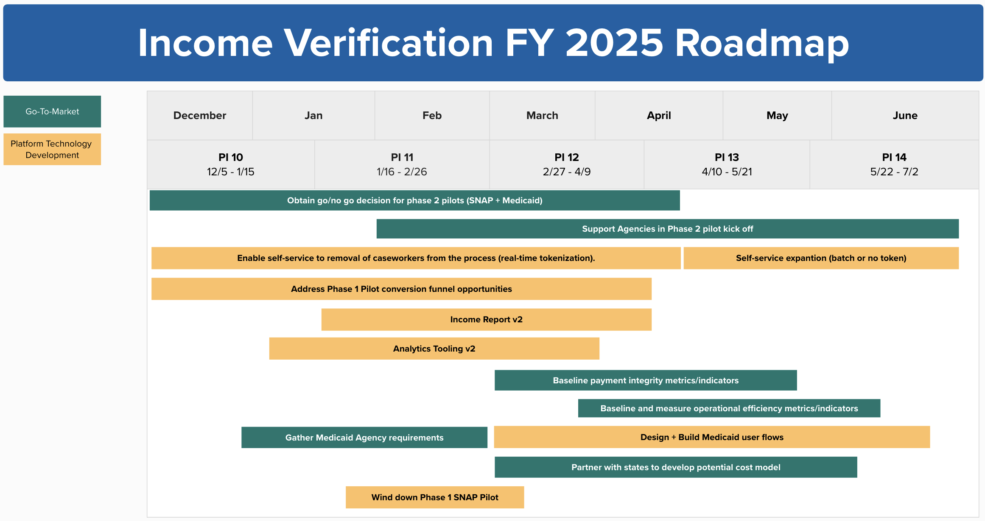
FY 2025, H1 Roadmap
14

Slide 15
Background
Consent Based Verification
P

Slide 16
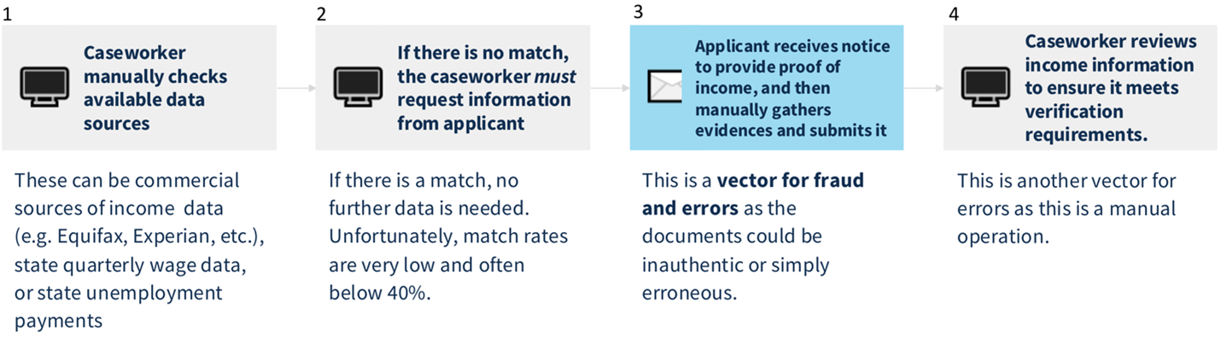
The consent-based verification intervention is a feature that allows means tested public benefit systems to receive applicant’s income data directly from payroll providers.
After applicant consent, the tool automatically pulls income data from the source of truth (the paystub), which will increase the accuracy and quality of data flowing into eligibility and enrollment systems.
This automation will improve programs’ payment integrity, operational efficiency, and provide a better customer experience.

Slide 17
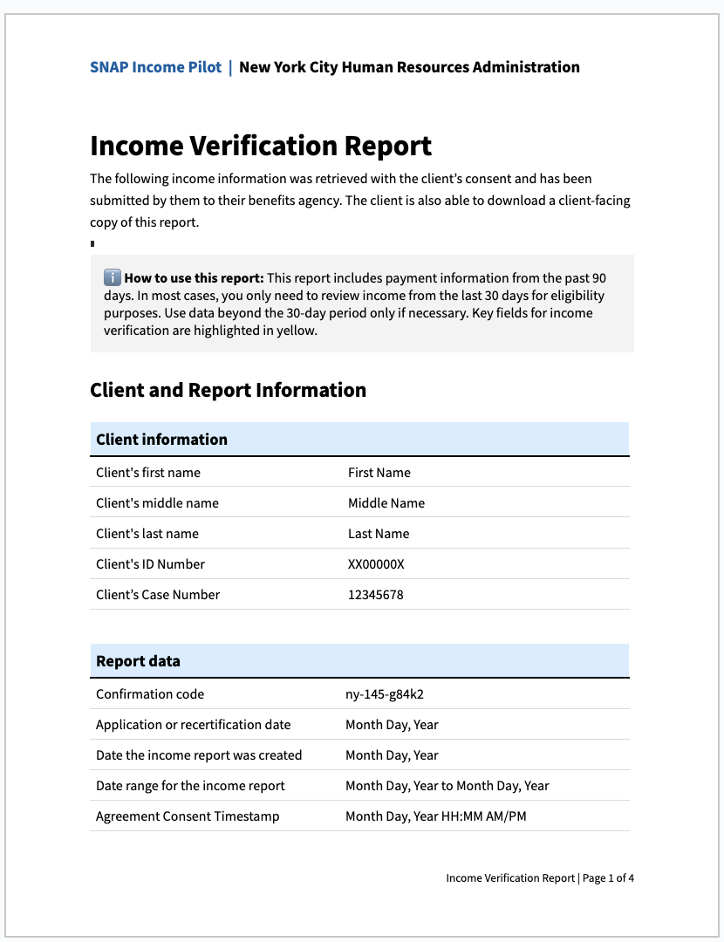
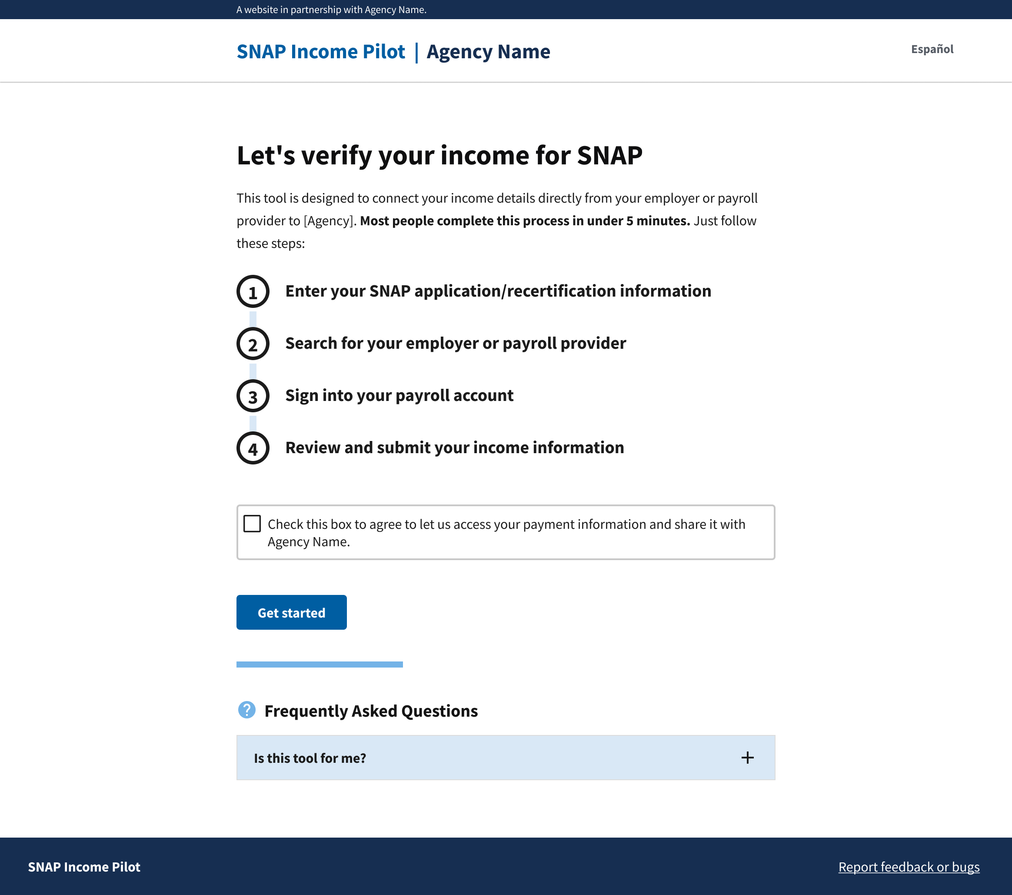
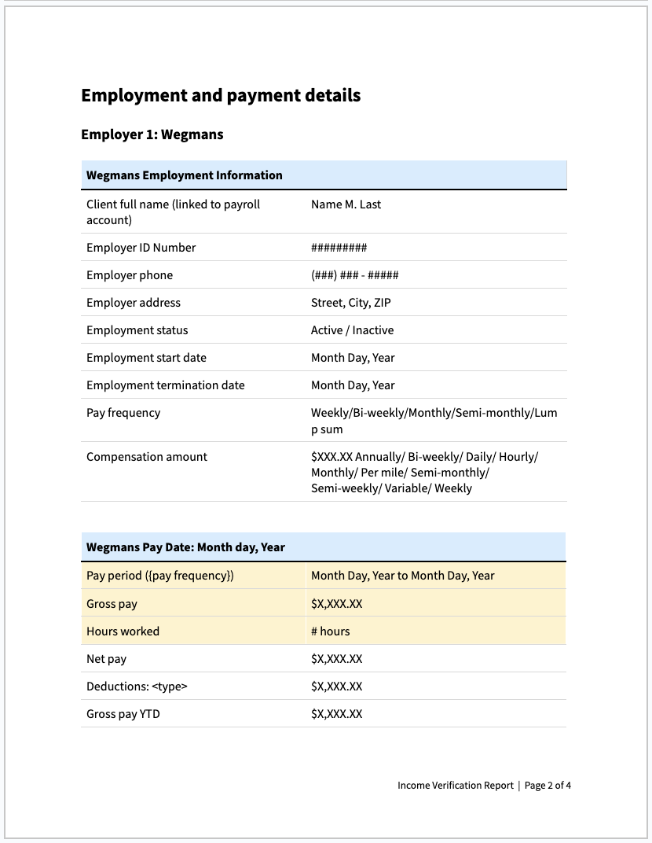
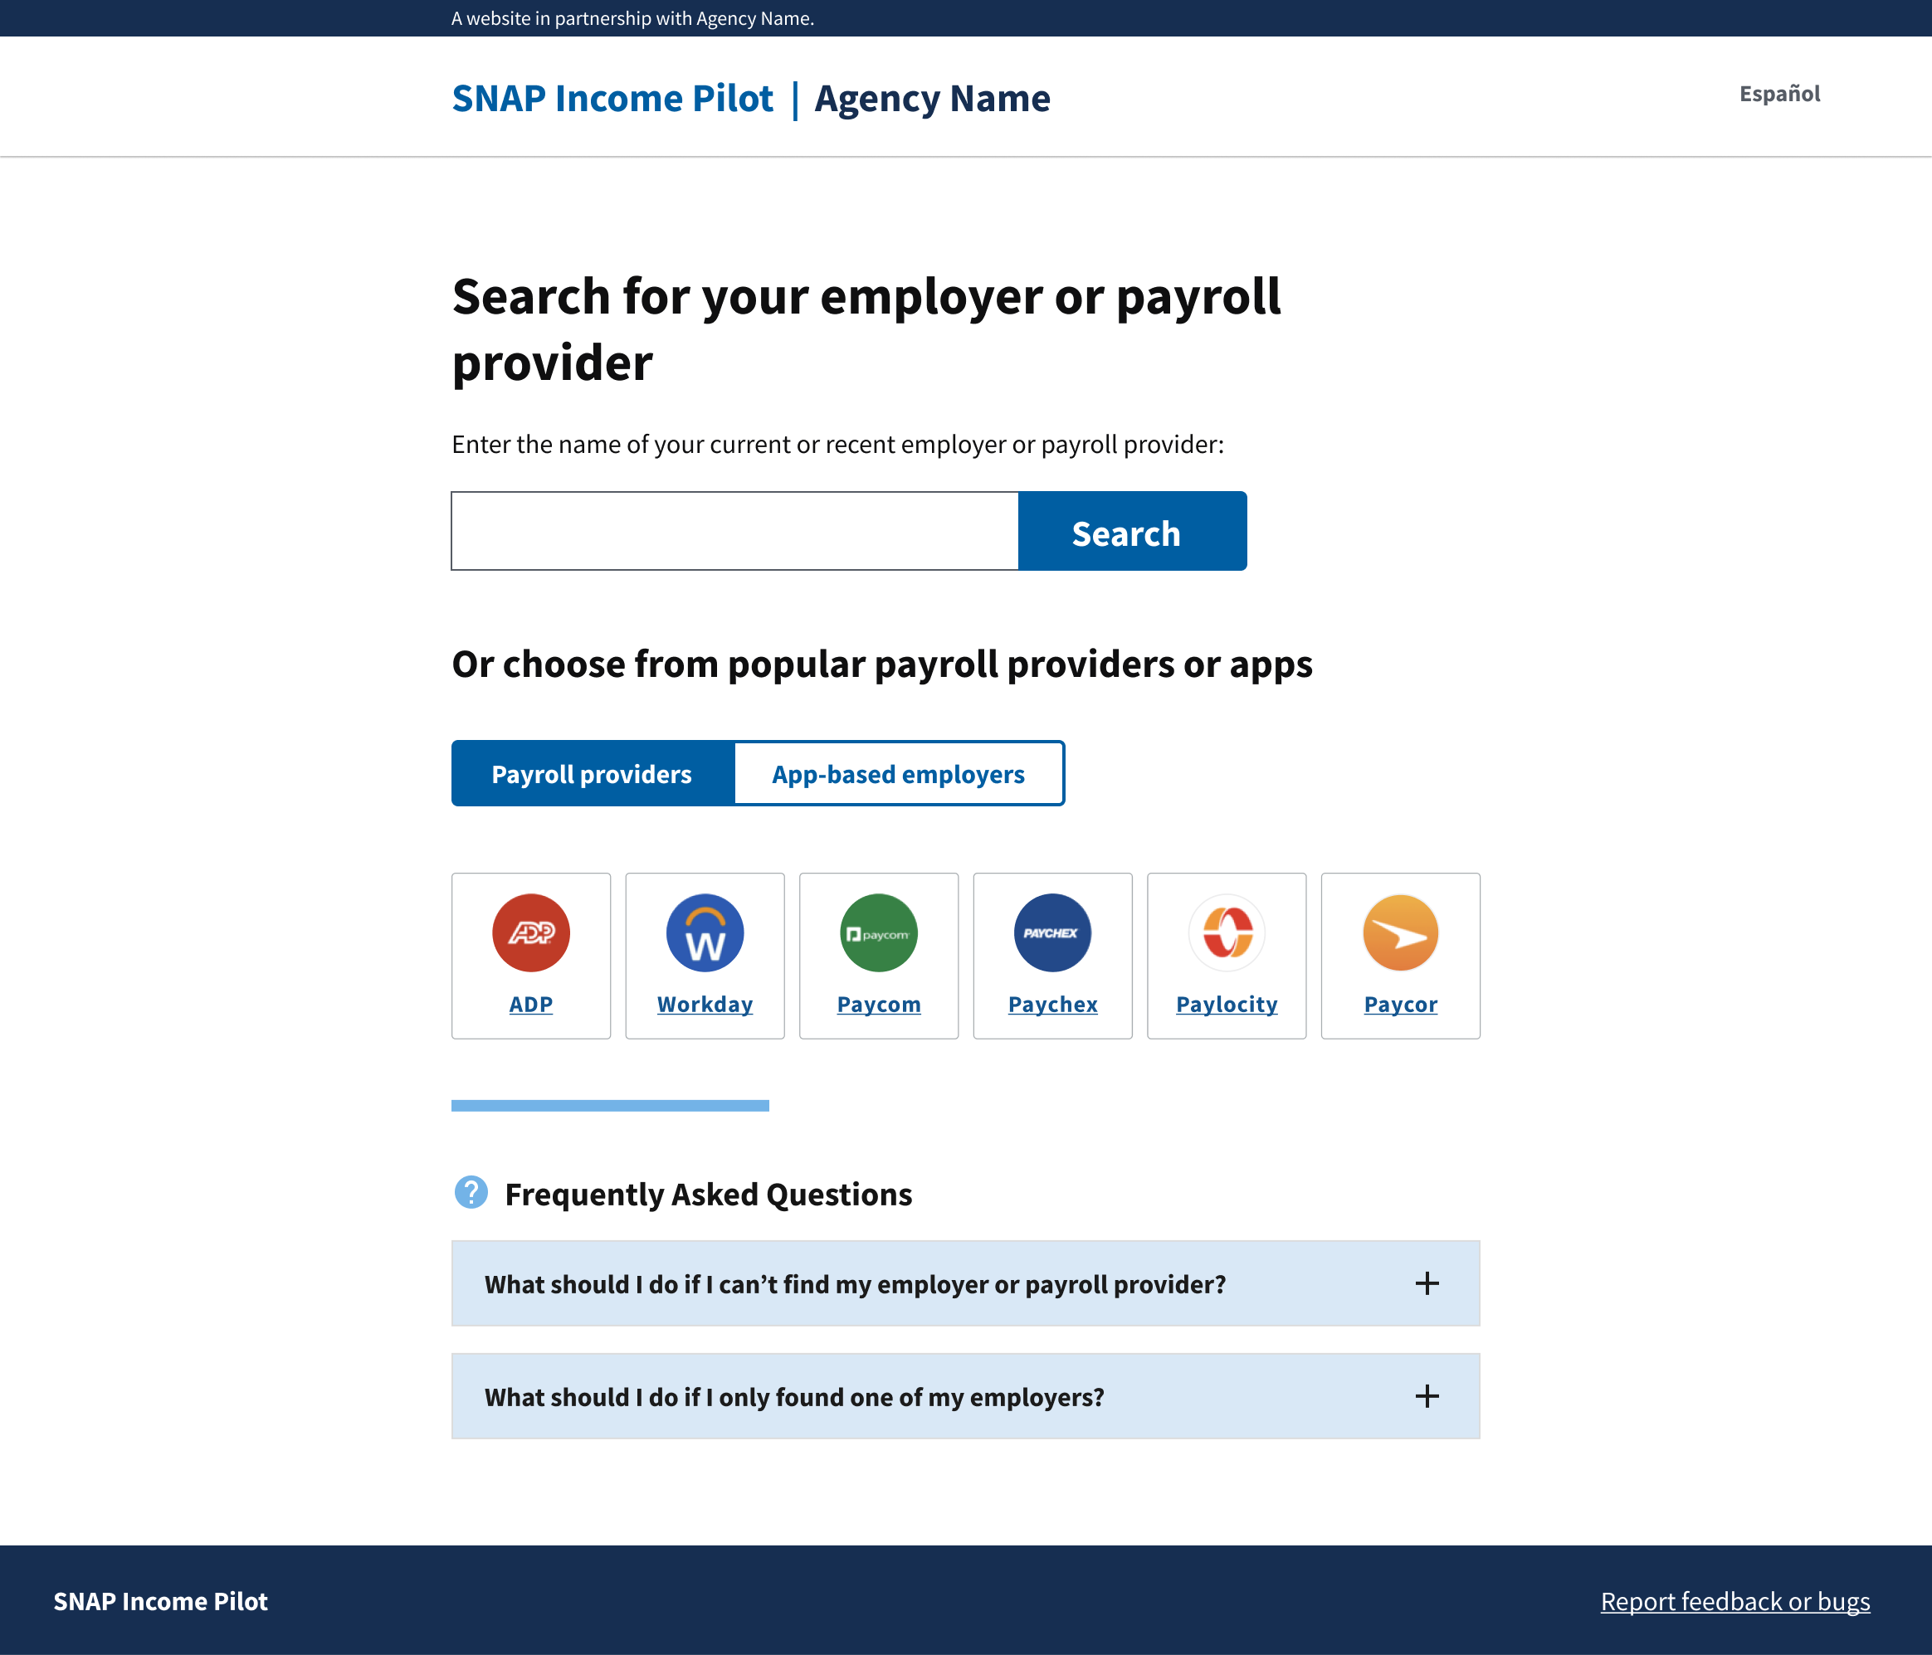
How consent-based verification works
An easy-to-use tool for W-2 and app-based workers... Applicant consents to share their income data directly with the requesting agency by using their payroll credentials
…and an easy-to-process Income Report which automatically formats the necessary paystub information for eligibility workers to take action
Agency Name

Slide 18
Background
Payment integrity + why this is important

Slide 19
What is payment integrity?
In short, payment integrity is trying to make sure agencies provide:
the right amount of benefit
at the right time
to the right person
following the right process *
It isn't just a measure of paying too much - it's also paying too little or determining someone is ineligible when they are eligible for benefits.
Correctly verifying earned income is a large part of payment integrity and mistakes will show up in payment error rates (an aspect of payment integrity).
*CMS.gov, Process errors count as payment integrity errors, changes occurred in 2021.
19

Slide 20
What are improper payments?
An improper payment is any payment that should not have been made or that was made in an incorrect amount under statutory, contractual, administrative, or other legally applicable requirement.
The term “improper payment” consists of two main components:
improper payments resulting in a monetary loss to the Government
improper payments that do not result in a monetary loss to the Government
include under-payments and payments made to the right recipient for the right amount, but the payment was not made in strict accordance with statute or regulation.
Although working to reduce all improper payments is important, prevention of improper payments resulting in a monetary loss is the federal government’s highest priority.
https://www.paymentaccuracy.gov/

Slide 21
Key groups who care about Payment Integrity
SNAP Program, Food and Nutrition Service (SNAP/ FNS/ USDA)
FNS has robust quality control processes that measure over and underpayments per state. Helping states keep their error rates low helps the program continue to help food insecure applicants
Center for Medicare and Medicaid Service (CMCS)
Medicaid Integrity Program: Helps states prevent fraud, waste, and abuse in Medicaid and CHIP
Medicaid Eligibility Quality Control (MEQC) Program: Helps states evaluate their Medicaid eligibility processes
Office of Management and Budget (OMB)
OMB publishes data and creates scorecards at Paymentaccuracy.gov
Government Accountability Office (GAO)
GAO is an independent, non-partisan agency that works for Congress. GEO examines how taxpayer dollars are spent and provides Congress and federal agencies with objective, non-partisan, fact-based information to help the government save money and work more efficiently. GAO also maintains the FraudNet hotline to support accountability across the federal government
BFS Office of Payment Integrity
Helps federally funded programs make timely decisions to identify, prevent, and recover fraud and improper payments
21

